Slide 1
The Sanitation Team Business Model
Water Sector Trust Fund
Version:2.0
Last Update: August 2017

Slide 2
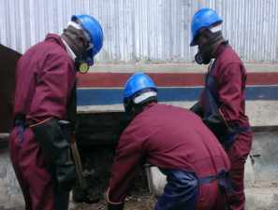
What is Sanitation Team?
The Sanitation Team is a group of entrepreneurs offering sanitation emptying, transportation, reuse and disposal services among other activities
In the UBSUP programme, the Sanitation Team are the key stakeholders who will assist in the completion of the sanitation value chain.
Without the Sanitation Teams, our toilets cannot be emptied and the UDDT matter cannot be transported to the Decentralised Treatment Facilities (DTF)
The Sanitation Teams also play a key role in reuse and disposal
So many activities are dependant on the Sanitation Team!
So how can it be a business?

Slide 3
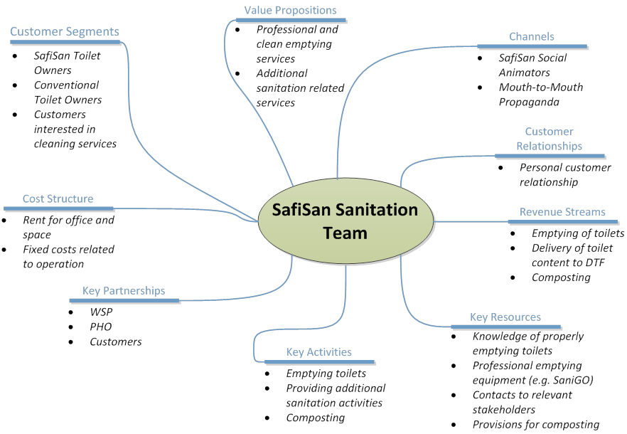
Summary of the various components

Slide 4
Who is your customer ?
Includes anybody with a SafiSan UDDT
Sanitation Teams can also be involved in Solid Waste Management in the plots that have SafiSan toilets (wet and dry toilet)
A dry toilet is a UDDT, a wet toilet is a pour flush toilet or cistern flush toilet
Therefore, the following customer segments can be identified:
1) SafiSan UDDT owners
2) SafiSan wet toilet owners who would like to have their organic waste collected in their plots
Notes:
Explain what wet and dry means

Slide 5
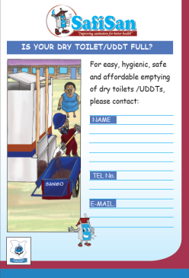
Value Propositions
The profession of existing manual emptiers is neither legalized nor formalized. The SafiSan Sanitation Teams will:
  Have the required licenses to be able to operate in low income areas
  Due to the active promotion of the service (through posters) and the provision of corporate overalls and tools, the team members will be recognizable in the low income areas

Slide 6
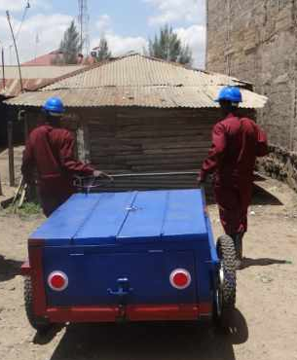
Value Propositions Cont’d
This will result in various deliverables by the Sanitation Team:
Professional emptying service for SafiSan toilets: Members will be trained on efficient and clean emptying of the SafiSan UDDTs using the SaniGo.
Composting: Sanitation Teams could operate small composting fields and sell the end product as soil conditioners or fertilizer.
Additional services: All services related to sanitation can be covered by the team.
Solid waste management

Slide 7
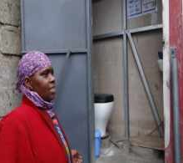
How do we reach our customers?
There are different channels for reaching the customer segments:
Through the WSP which is in charge of SafiSan project implementation.
Through the SafiSan artisans.
Direct marketing and after sale services. Posters have been developed to market activities in LIAs

Slide 8
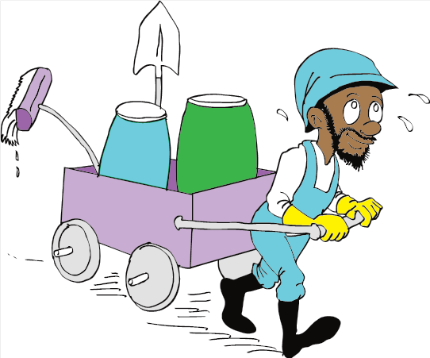
Customer Relationships
A direct relationship with the customer is foreseen.
The Sanitation Team will be dealing with the toilet owners directly and any negotiations, either on price, frequency of emptying or additional services to be offered, will be between them without the necessary involvement of other parties.

Slide 9
Revenue Streams
Main revenue stream is the emptying of SafiSan and other toilets
A commission based recommendation between the sanitation teams and the SafiSan artisan
Collecting organic waste in the plots with SafiSan toilets

Slide 10
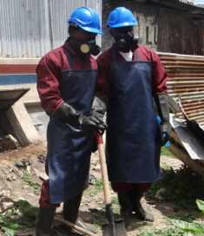
Key Resources
The professional equipment to empty SafiSan toilets.( SaniGo) and the protective equipment
Contact with the other important SafiSan stakeholders, such as the SafiSan Artisan, the PHOs, WSPs, Social Animators etc. They will ensure access to potential clients, demand creation of improved sanitation and (free) promotion of the sanitation services.

Slide 11
Key Activities
The services should be enhanced to emptying services for conventional toilets for appropriate machines, professional cleaning services, composting, and promoting of SafiSan toilets.
If the products are enhanced this should be indicated in their registration certificate (Solid Waste Management and Environment Sanitation)

Slide 12
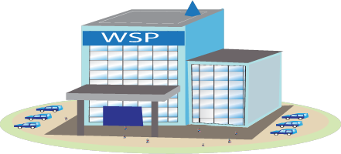
Key Partnerships
In terms of promotion of services and identifying potential customers, partnerships with the WSP, the PHO and SafiSan Artisans should be created.
Service promotion can be as well very effective through community operating institutions (e.g. churches, mosques, schools).

Slide 13




Cost structure
The fixed costs for the SafiSan Sanitation Team are expected to be limited. An office and/or warehouse may be needed in order to store the equipment (SaniGo) safely.
Variable costs mainly occur on cleaning and maintenance products. They vary proportionally with the number of customers.

Slide 14
Guiding factors
Price to set for the emptying service- Considering the various costs that will be incurred during the setting up of the business e.g.
Application fee charges (when registering as a group)
Vaccination fees (against various diseases)
Licensing fee charges (to use some of the equipment)
Market for the emptying- Are there enough UDDTs to sustain the emptying business and keep the business afloat? Innovation- Incorporating other activities such as solid waste management to ensure that the Sanitation Teams have enough income and activities

Slide 15

Some discussion points
What do you think would make you the most money?
Emptying UDDTs or Solid Waste Management?
What further activities apart from the ones above can be incorporated into your work?
What vaccinations are required?
How to cover the initial costs of vaccinations?
Notes:
Notes for discussions. At this time the floor is opened and the session is more interactive.

Slide 16
Some discussion points
How will you finance the cleaning equipment costs?
What are the registration costs?
How much will you charge for emptying a UDDT? (one vault, 2 vaults,)
How much will you charge for collecting organic waste in the plots?
Notes:
Notes for discussions. At this time the floor is opened and the session is more interactive.

Slide 17
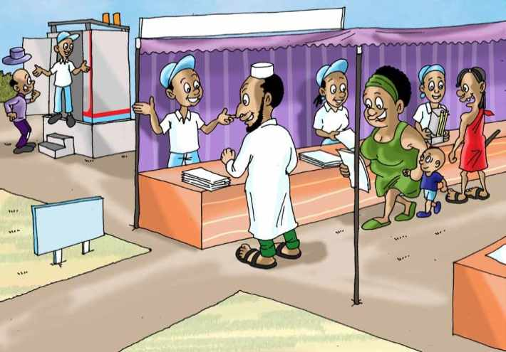
Thank you! Any questions?

